Slide 1
Understanding Vicarious Trauma, Coping strategies for frontline Workers
Ana Mercedes Guerra. MSW. RSW

Slide 2
Self awareness & take care of your needs
This Photo by Unknown Author is licensed under CC BY-SA-NC
Self compassion

Slide 3
Outline of today’s webinar
What is Vicarious Trauma
Recognise vicarious trauma in self and others.
Impact of VT on Organizations
Reflections on Resilience
Coping strategies
Reflection questions to discuss

Slide 4
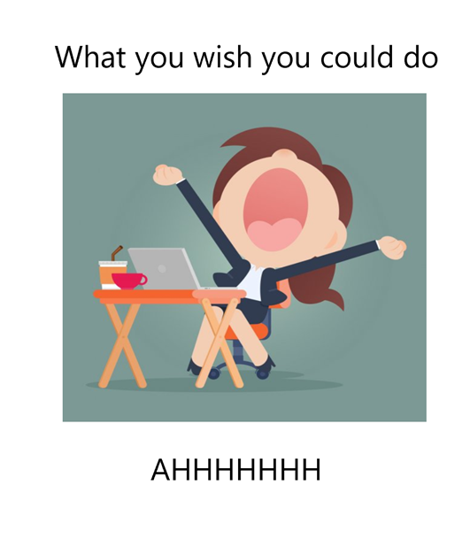
Frontline workers

Slide 5
Burnout vs Vicarious Trauma (compassion fatigue)
Burnout (or occupational burnout) is a psychological term referring to a general exhaustion and a lack of interest or motivation regarding one’s work.
Vicarious trauma also called Compassion fatigue, refers to the negative emotions that individuals feels from helping others at work. Common in the “helping professional” (e.g. Counsellors, crisis advocates, social workers, frontline workers)
The difference between compassion fatigue and burnout is their origin. Compassion fatigue-Vicarious trauma originates from dealing with victims of Trauma and burnout originates from occupational stress and being overworked.

Slide 6
What is Vicarious trauma
Refers to the cumulative transformative effect on the helper working with the survivor of traumatic life event
Process of change that occurs when a provider cares about other that have been hurt and feels responsible/committed to help
Results from psychological and spiritual disruption that affect the way we see ourself, the world and what matters most to us. This leads to physical, psychological, spiritual, behavioral symptoms of VT

Slide 7
Signs and Symptoms of vicarious Trauma
Apathy
Tiredness/exhaustion
Irritability
Helplessness/hopelessness
Sadness
Forgetfulness/mental lapses
Absence from work/lateness
Cynicism
Feeling of failure/self-blame
Difficulty problem solving

Slide 8
Helpless
Frustrated
Annoyed
Afraid
Angry
Overwhelmed
Anxious
Questions competency

Slide 9
Recognizing vicarious trauma in self and other
Changing the subject
Being angry or sarcastic with clients
Using humor to change or minimize the subject.
Blaming clients for their experiences
Faking listening
Not being able to pay attention
Suggesting the client to “get over It”

Slide 10
Risk Factors: Individual
Personality
Coping style, lack of self care
Personal history
Life circumstances (always changing)
Work style
Lack of training or experience
Lack of social support
Spiritual resources

Slide 11
Protective Factors: Individual
Self awareness
Compassion
Able to seek support: able to express feelings
Home/life balance; able to set boundaries
Self care strategies
Open to leaning
Personality (optimism)
Access to therapy or counselling

Slide 12
Break up rooms… 5 minutes
Share amongst yourselves ways that help you to cope with the impact of caring for others who had been impacted by trauma.

Slide 13
-Normalizing feelings and self expression
-Awareness of consumption/news or substance.
-Connection to others, traditions, nature
-Self compassion and love

Slide 14
Risk Factors: Work Environment
Work overload
Lack of autonomy over work
Role in the workplace
Lack of communication or relationship with co workers
Homogenous caseload
Lack of peer support, ability to debrief
Poor leadership style or lack of supervisory support
Lack of consistency/predictability
Conflict between personal values and job requirements
Worker safety and sense of belonging
Lack of fainnes in the workplace
No support for reflective practice

Slide 15
Break up rooms… 5 minutes
What can the work environment do to help support someone who may be experiencing vicarious trauma?

Slide 16
Protective Factors: Work Environment
Workers are recognized, acknowledged, respected, valued.
Workers feels safe and a sense of belonging.
Peer support is integrated into the work environment.
Reflective practice is encouraged and expected.
Open communication between peers and workers and leaders.
Leaders identified vicarious trauma and take action.
Adequate supervision, positive leadership style (opend to feedback and good decision making)
Consistent policies and practices.
Agency has resources to meet demand of work and provide support to works
Workers have opportunity to continue learning & grown.

Slide 17
Individual Prevention & Intervention: ABC
Awareness of one’s needs, emotions, limitation
Balance: Work –Play & rest
Connections with oneself, to others and to a sense of purpose.

Slide 18
How to build resilience
What is resilience: refers to the ability to successfully adapt to stressors, maintaining a psychological well-being in the face of adversity .
The ability to “bounce back” from difficult experiences. Resilience is not a trait that people either have or don’t have
Resilience means being able to cope with tough events, when something bad happens, you still feel anger, grief and pain. But you can keep going both physically and psychologically. Resilience isn’t about putting up with something tough or coping on your own, In fact, being able to reach out to others for support is a key part of being resilience.
Resilience in the workplace? Is the ability to withstand and recover from workplace trauma and stressful situation, including adapting to changing circumstances and maintaining wellbeing through self-care practices
It entails the ability to welcome change and uncertainty as opportunities rather than threats and to maintain a calm attitude in tough situations.

Slide 19
Who or what is it important for you to connect to?
What does connection look like for you? How do you stay connected?
What do you see possible changes in your workplace.
Reflection Questions
Break out rooms

Slide 20
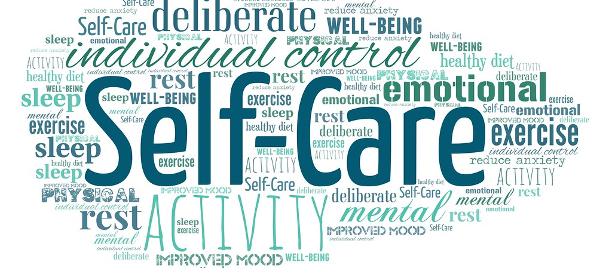
Thank you!
This Photo by Unknown Author is licensed under CC BY
anamercedesguerra.counselling@gmail.com

